Slide 1

Chapter 3 Arrays

Slide 2

Outline
The Array Workshop Applet
The basics of Arrays in Java
Divide program into Classes ☆
Class interfaces ☆
The Ordered Workshop Applet
Java code for an Ordered Array
Logarithms
Storing Objects
Big O Notation

Slide 3


The Array Workshop Applet
You are here!
Suppose that you‘re coaching (执教)a kids-league baseball team and you want to keep track of which players are present at the practice field.
You need an attendance monitoring program for your laptop; a program that maintains a database of the players who have shown up for practice.

Slide 4
The Array Workshop Applet
Use a simple data structure to hold (保存)this data. There are several actions you would like to be able to perform:
• Insert a player into the data structure when the player arrives at the field.
These three operations will be the fundamental ones in most of the data storage
structures we'll study.
• Check to see if a particular player is present by searching for his or her number in the structure.
• Delete a player from the data structure when the player goes home.

Slide 5
The Array Workshop Applet
A Workshop applet.
This applet demonstrates the three fundamental procedures mentioned earlier:
• The Ins button inserts a new data item.
• The Find button searches for specified data item.
• The Del button deletes a specified data item.
Each button press in a Workshop applet corresponds to a step that an algorithm carries out.
The more steps required, the longer the algorithm takes.

Slide 6

The Array Workshop Applet
The new item is simply inserted in the next available space.
Insertion
The search algorithm must look through an average of half the data items to find a specified item.
Searching
If N is the number of items, what is the average number of steps needed to find an item?
N/2
Deletion
找到指定的元素并删除它后,还必须把后继的元素往前依次移动，以保证不出现“空洞”。

Slide 7
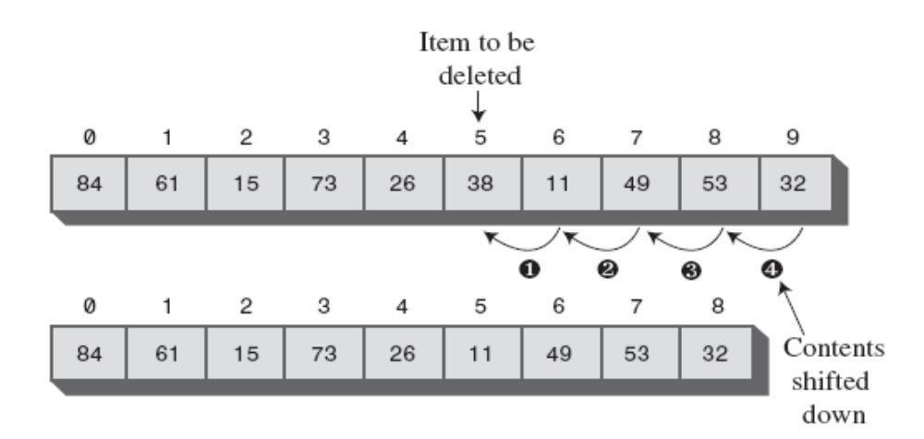
The Array Workshop Applet
After locating the specified item and deleting it, the applet must shift the contents of each subsequent cell down one space to fill in the hole.
Deletion

Slide 8
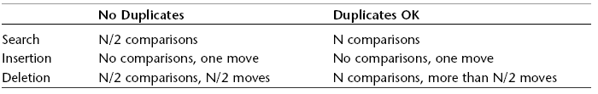
The Array Workshop Applet
The Duplicates Issue（有/无重复元素的情况）

Slide 9
The basics of Arrays in Java
Creating an Array
In Java, array are treated as objects
int[] intArray; // defines a reference to an array
intArray = new int[100]; // creates the array, and
// sets intArray to refer to it
Or you can use the equivalent single-statement approach:
int[] intArray = new int[100];
Placing the [] after the int makes it clear that the [] is part of the type, not the name.
An alternative syntax(另一种写法)
int intArray[] = new int[100];

Slide 10
The basics of Arrays in Java
Arrays have a length field, which you can use to find the size of an array:
int arrayLength = intArray.length; // find array size
As in most programming languages, you can’t change the size of an array after it’s been created.

Slide 11
The basics of Arrays in Java
Accessing Array Elements
Array elements are accessed using an index number in square brackets.
temp = intArray[3]; // get contents of fourth element of array
intArray[7] = 66; // insert 66 into the eighth cell
The first element is numbered 0, so that the indices in an array
of 10 elements run from 0 to 9.

Slide 12
The basics of Arrays in Java
Automatically initialized to 0
Initialization
AutoData[] carArray = new AutoData[4000];
int[] intArray = { 0, 3, 6, 9, 12, 15, 18, 21, 24, 27 };
The size of the array is determined by the number of
values in this list.

Slide 13
The basics of Arrays in Java
An Array Example
In this program, we
create an array called arr,
place 10 data items (kids’ numbers) in it,
search for the item with value 66,
display all the items,
remove the item with value 55,
display the remaining 9 items.

Slide 14

The basics of Arrays in Java
Give some comments on this program.
An old-fashioned（老套的） procedural program.
Hard to understand.
What can we do to improve the design?
Firstly, we’ll separate the data storage structure (the array) from the rest of the program. The remaining part of the program will become a user of the structure.
Secondly, we’ll improve the communication between the storage structure and its user.

Slide 15

Dividing a Program into Classes
We can reap many benefits by dividing the program into classes.
Data
storage structure
Big Method
The other parts
of old method

Slide 16
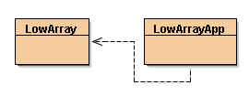

Dividing a Program into Classes
Classes LowArray and LowArrayApp
In lowArray.java, we essentially wrap the class LowArray around an ordinary Java array.
LowArrayApp creates an object of the LowArray class and uses it to store and manipulate data.
Think of LowArray as a tool and LowArrayApp as a user of the tool.
This is a valuable first step in making a program object oriented!

Slide 17

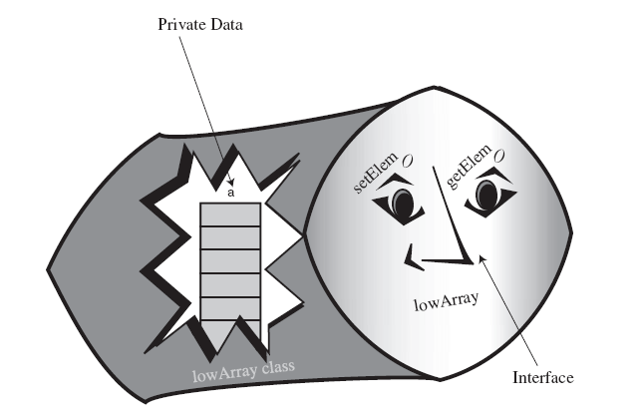
Class Interfaces
How do these classes interact with each other?
Through class interface

Slide 18
Class Interfaces
Not So Convenient
The methods setElem() and getElem() operate on a low conceptual level, performing exactly the same tasks as the [] operator in an ordinary Java array.
Who’s Responsible for What?
In a typical program, the user of the data storage device don’t need to know the array indices(索引).

Slide 19
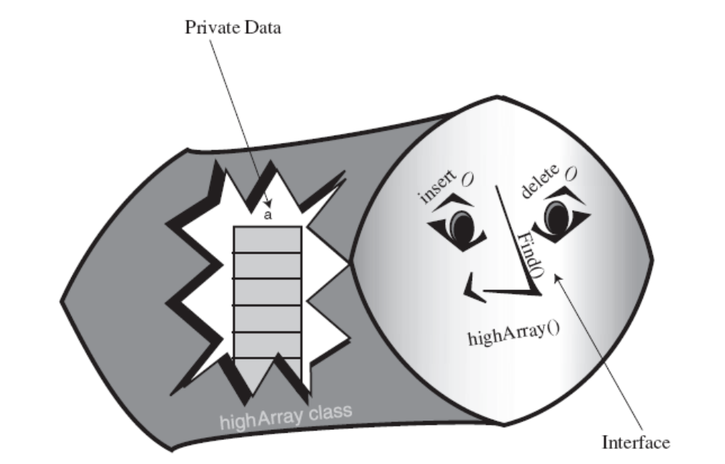
Class Interfaces
The highArray.java Example
An improved interface for the storage structure class

Slide 20


Class Interfaces
The User’s Life Made Easier
The class user class need not worry about index numbers or any other array details.
The class user class doesn’t even need to know what kind of data structure the HighArray class is using to store the data.
In the next section, we’ll see the same interface used with a somewhat different data structure.
What is abstraction?
How to do
What to do
How to do
What to do

Slide 21


The Ordered Workshop Applet
What is ordered array?
An array in which the data items are arranged in order of ascending(递增) key values.
How could we keep it in order when we insert a new item?
The correct location must be found for the insertion
All the larger values must be moved up to make room.
Why would we want to arrange data in order?
We can speed up search times dramatically using a binary search.

Slide 22
The Ordered Workshop Applet
Linear Search vs Binary Search
The same way as the searches in the unordered array
Much faster than linear search, especially for large arrays
A new Workshop Applet

Slide 23
Java Code for an Ordered Array
public int find(long searchKey){
int lowerBound = 0;
int upperBound = nElems-1;
while(true) {
int curIn = (lowerBound + upperBound ) / 2;
if(a[curIn]==searchKey)
return curIn; // found it
else if(lowerBound > upperBound)
return nElems; // can’t find it
else {// divide range
if(a[curIn] < searchKey)
lowerBound = curIn + 1; // it’s in upper half
else
upperBound = curIn - 1; // it’s in lower half
} // end else divide range
} // end while
} // end find()
The heart of this class is the find() method, which uses a binary search to locate a specified data item.
在后续章节会讲到递归实现的二分查找。

Slide 24
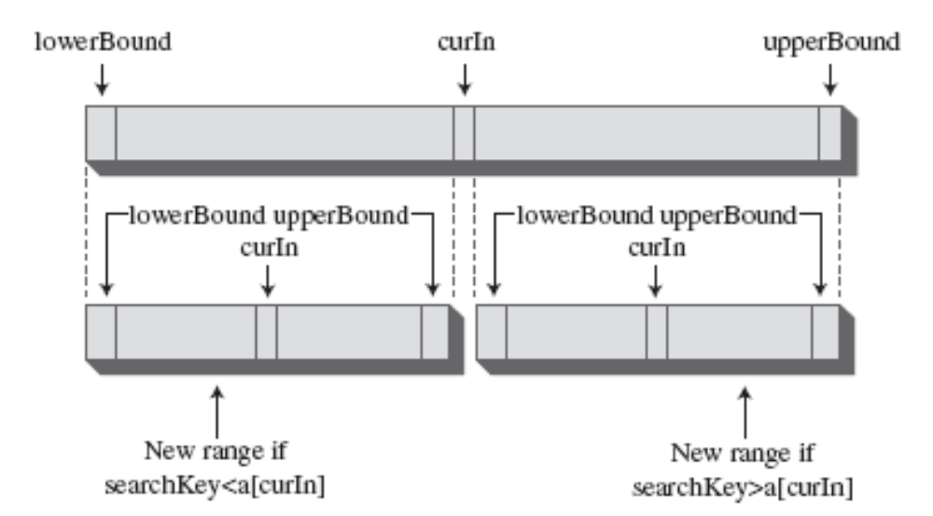
Java Code for an Ordered Array
Each time through the loop we divide the range in half. Eventually, the range will get so small that it can’t be divided any more.

Slide 25

Java Code for an Ordered Array
The OrdArray Class
We could have used a binary search to locate the position where a item will be inserted or deleted.
Ordered arrays are useful in situations in which searches are frequent, but
insertions and deletions are not.
a new size() method
Advantages & Disadvantages
The major advantage is that search times are much faster than in an unordered array.
The disadvantage is that insertion takes longer because all the data items with a higher key value must be moved up to make room.

Slide 26

Logarithms
Differences between binary search and linear search
Range | Comparisons Needed
 | Binary search (maximum) | Linear search (average)
10 | 4 | 5
100 | 7 | 50
1,000 | 10 | 500
10,000 | 14 | 5000
100,000 | 17 | 50000
1,000,000 | 20 | 500000
10,000,000 | 24 | 5000000
100,000,000 | 27 | 50000000
1,000,000,000 | 30 | 500000000

Slide 27
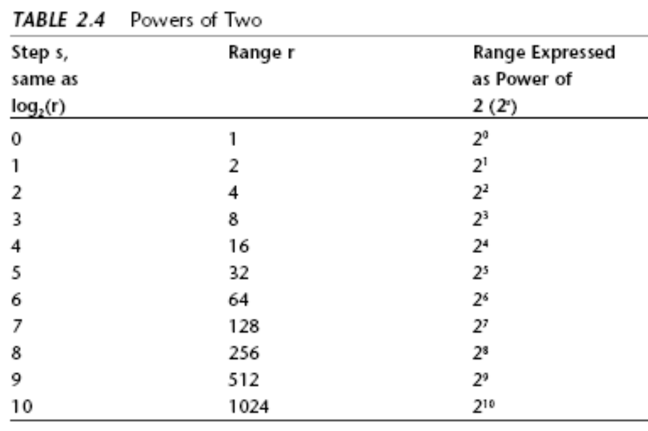
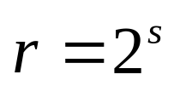
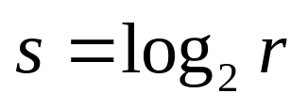
Logarithms
The Equation
If
s → steps
r → range,
then the equation is
The Opposite of Raising Two to a Power
As r grows larger, its logarithm doesn’t grow nearly as fast.

Slide 28

扩展阅读
斐波那契查找（Fibonacci Search，或者“黄金分割搜索”）
  时间复杂度为O（log₂(log₂n)）,因此平均情况下，斐波那契查找优于二分查找，但最坏情况下则差于二分查找。
  斐波那契查找优点是只有加、减运算;二分查找有除法运算（但在目前CPU支持的指令集下区别不大）。
  斐波那契查找的缺点是每次必须计算下个级数。
  Java实现参见http://jerrygao.iteye.com/blog/101283
Notes:
public class Fibonacci {
/*输出斐波那契数*/
public static void printFibonacciNumber(long f1,long f2,int n){//the first number, the second number,the totel fibonacci numbers
for(int i = 1;i <= n;i++){
System.out.print(f1+" "+f2+" ");//先输出前两个数
if(i % 5 == 0)System.out.print("\n"); //换行
f1 = f1+f2; //计算下两个数
f2 = f1+f2;
}
/*后数除前数为黄金分割点*/
System.out.print("\n"+"-------------------------------------"+"\n");
System.out.println((double)f2/f1);//越到后边，后数除前数越接近黄金分割点
}
/*输出斐波那契数组*/
public static void printFibonacciArray(long f1,long f2,int n){//the first number, the second number,the totel fibonacci numbers
long f[] = new long[n];
f[0]=f1;
f[1]=f2;
for(int i =2;i <n;i++){
f[i]=f[i-2]+f[i-1]; //数组的第三个数开始为前两个数的和
}
System.out.println("-------------------------------------"+"\n");
System.out.println(java.util.Arrays.toString(f)); //把数组转化成String输出
}
/**
* main method
* @param args
*/
public static void main(String[] args) {
Fibonacci.printFibonacciNumber(0, 1, 10);//print the 20 advanced fibonacci number
Fibonacci.printFibonacciArray(0, 1, 20);
}
}

Slide 29

Storing Objects(对象的存储)
Usually, the data items (records) you want to store are combinations of many fields.
class Person{
private String lastName;
private String firstName;
private int age;
//-----------------------------------------------------------
public Person(String last, String first, int a)
{ // constructor
lastName = last;
firstName = first;
age = a;
}
//-----------------------------------------------------------
public void displayPerson(){
System.out.print(“ Last name: “ + lastName);
System.out.print(“, First name: “ + firstName);
System.out.println(“, Age: “ + age);
}
//-----------------------------------------------------------
public String getLast() // get last name{
return lastName;
}
} // end class Person

Slide 30

Storing Objects
The classDataArray.java Program
This shows that class objects can be handled by data storage structures in much the same way as primitive types.
借助Java的泛型（Generic）机制，我们可以只需实现某种数据结构一次，之后便可以作为其他数据类型（Primitive Types or Object Types）的容器。
练习：通过泛型机制，改造HighArray使其能够存储Person对象并进行增删改查。
Notes:
import java.lang.reflect.Array;
public class GenericHighArray<T> {
private T[] a; // ref to array a
private int nElems; // number of data items
public GenericHighArray(int max,Class clz) // constructor
{
a = (T[]) Array.newInstance((Class<?>) clz, max); // create the array
nElems = 0; // no items yet
}
// -----------------------------------------------------------
public boolean find(T searchKey) { // find specified value
int j;
for (j = 0; j < nElems; j++)
// for each element,
if (a[j].equals(searchKey)) // found item?
break; // exit loop before end
if (j == nElems) // gone to end?
return false; // yes, can't find it
else
return true; // no, found it
} // end find()
// -----------------------------------------------------------
public void insert(T value) // put element into array
{
a[nElems] = value; // insert it
nElems++; // increment size
}
// -----------------------------------------------------------
public boolean delete(T value) {
int j;
for (j = 0; j < nElems; j++)
// look for it
if (a[j].equals(value))
break;
if (j == nElems) // can't find it
return false;
else // found it
{
for (int k = j; k < nElems; k++)
// move higher ones down
a[k] = a[k + 1];
nElems--; // decrement size
return true;
}
} // end delete()
// -----------------------------------------------------------
public void display() // displays array contents
{
for (int j = 0; j < nElems; j++)
// for each element,
System.out.print(a[j] + " "); // display it
System.out.println("");
}
// -----------------------------------------------------------
} // end class HighArray
////////////////////////////////////////////////////////////////
public class HighArrayApp
{
public static void main(String[] args)
{
int maxSize = 100; // array size
GenericHighArray<String> arr; // reference to array
arr = new GenericHighArray<String>(maxSize,String.class); // create the array
arr.insert("77L"); // insert 10 items
arr.insert("99L");
arr.insert("44L");
arr.insert("55L");
arr.insert("22L");
arr.insert("88L");
arr.insert("11L");
arr.insert("00L");
arr.insert("66L");
arr.insert("33L");
arr.display(); // display items
String searchKey = "22L"; // search for item
if( arr.find(searchKey) )
System.out.println("Found " + searchKey);
else
System.out.println("Can't find " + searchKey);
arr.delete("00L"); // delete 3 items
arr.delete("55L");
arr.delete("99L");
arr.display(); // display items again
} // end main()
} // end class HighArrayApp

Slide 31
Big O Notation
How to measure the efficiency （效率）of a computer algorithm？
In computer science, this rough measure（粗略的测量） is called “Big O” notation.
“Algorithm A is twice as fast as algorithm B”
------------It is meaningless
衡量算法复杂度的尺子---只用N，乘数和加数全都忽略。

Slide 32

Big O Notation（数学定义）
称一个函数g(n)是O(f(n))，当且仅当存在常数c>0和n₀≥1，对一切n>n₀均有|g(n)|≤c|f(n)|成立，也称函数g(n)以f(n)为界或者称g(n)囿于f(n)。
记作：g(n)=O(f(n))。

Slide 33
Big O Notation（数学定义）
称一个函数g(n)是O(f(n))，当且仅当存在常数c>0和n₀≥1，对一切n>n₀均有|g(n)|≤c|f(n)|成立，也称函数g(n)以f(n)为界或者称g(n)囿于f(n)。
记作：g(n)=O(f(n))。

Slide 34
Big O Notation（数学定义）
步骤
⒈ 找到执行次数最多的语句
⒉ 计算语句执行次数的数量级
⒊ 用大O来表示结果

Slide 35
Big O Notation（运算规则）
1） 顺序/选择结构中---加法规则
  T(n,m) = T₁(n) + T₂(m) = O (max (f(n),g(m))
2） 循环结构---乘法规则
  T(n,m) = T₁(n) * T₂(m) = O (f(n) * g(m))
3）常数C特例
  如果T₁(n) = O(c), c是一个与n无关的任意常数，T₂(n) = O (f(n)) 则T(n) = T₁(n) * T₂(n) = O (c*f(n)) = O(f(n)) 。
4）简单的比较法则
  c < log₂n < n < n*log₂n < n² < n³ < 2^{n} < 3^{n} < n! (c为常数)

Slide 36
Big O Notation（例子）
Insertion in an Unordered Array: Constant
It doesn’t depend on how many items are in the array.
It depends on:
the speed of the microprocessor;
how efficiently the compiler has generated the program code;
and other factors
the time →T
Constant →K
T=K
Linear Search: Proportional(成比例) to N
the total number of items → N
If an array is twice as big, searching it will take twice as long.
T=K*N/2

Slide 37
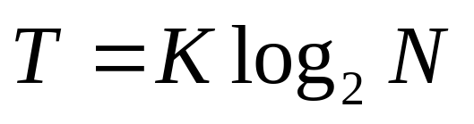
Big O Notation（例子）
Binary Search: Proportional to log(N)
Don’t Need the Constant
When comparing algorithms, you don’t really care about the particular microprocessor chip or compiler; all you want to compare is how T changes for different values of N, not what the actual numbers are. Therefore, the constant K isn’t needed.

Slide 38
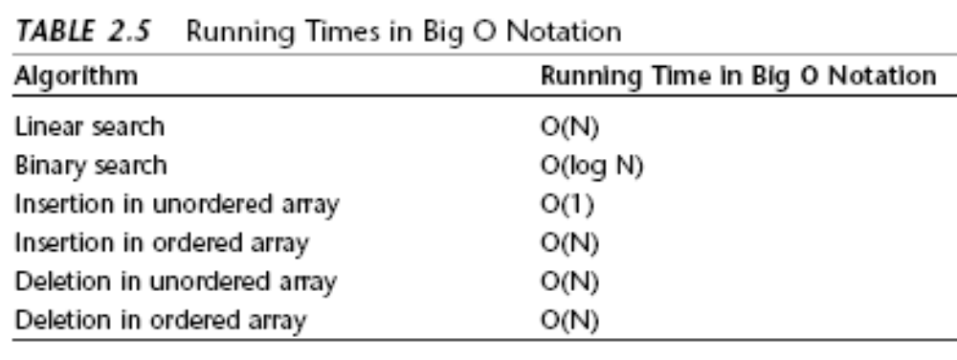
Big O Notation

Slide 39
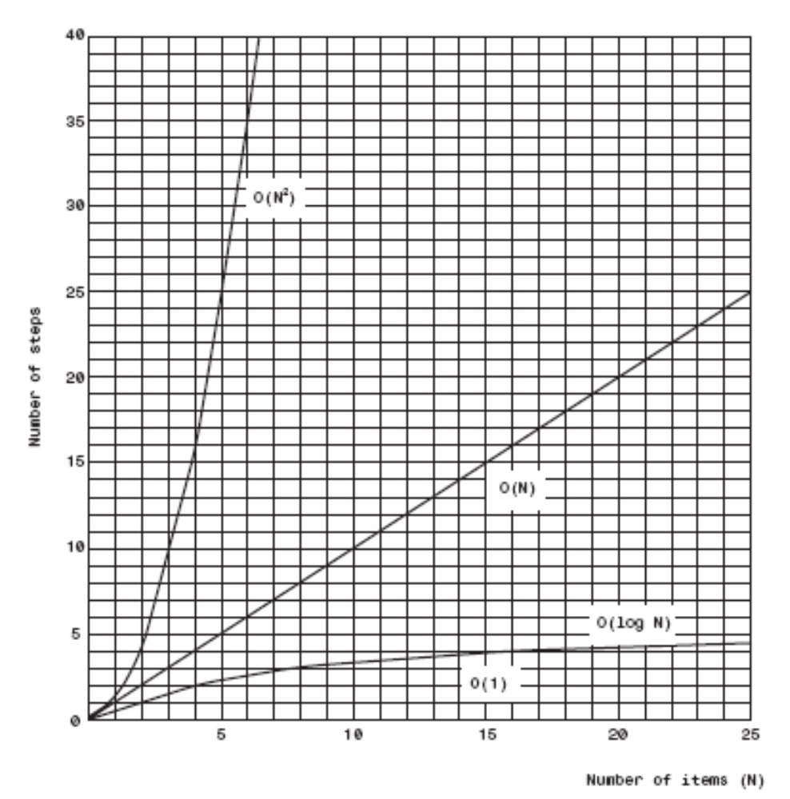
Big O Notation
Graph of Big O times

Slide 40
Why Not Use Arrays for Everything?
Disadvantages of Array
Performance is not so good.
Their size is fixed.
Java includes a class called Vector that acts much like an
array but is expandable（可扩展的）.
How could it do that?
If the class user is about to overflow the internal array in this class, the insertion algorithm creates a new array of larger size, copies the old array contents to the new array, and then inserts the new item.

Slide 41
Summary
Java中的数组是对象，由new操作符创建。
无序数组可以提供快速的插入，但查找和删除较慢。
将数组封装到类中可以保护数组数据不被随意更改。
类的接口由类用户可访问的方法(有时还有字段)组成。
类的接口被设计成使类用户的操作更加简单。
有序数组可以使用二分查找（binary search）。
对数log_{B}A的概念
Linear Search需要的时间与数组中数据项个数成正比。
Binary search需要的时间与数组中数据项个数的对数成正比。
大O表示法为比较算法的效率提供了一种方便的方法。
O(1)级时间的算法是最好的，O(logN)次之，O(N)为一般，O(N²)最差。

Slide 42
Assignment
Experiment:
Lab 2
Homework:
改造HighArray为泛型类，以便能存储对象

Slide 43
The End

